Slide 1
Crowdsourcing to Analyze Belief Systems Underlying Social Issues
Hunter Priniski
Keith J. Holyoak
Department of Psychology
University of California, Los Angeles
Research supported by NSF Grant BCS-1827374
Notes:
Hello, thanks for tuning into my practice talk for the upcoming cognitive science conference. And for those in Hakwan Lau’s lab watching a recording of this talk, hello!
In this presentation, I will introduce some preliminary findings from naturalistic data on how people reason about and support their capital punishment attitudes.

Slide 2
Notes:
It is not news that many people are eager to share their opinions on the internet. Particularly opinions related to politics, morality, science, and law.
*click*

Slide 3
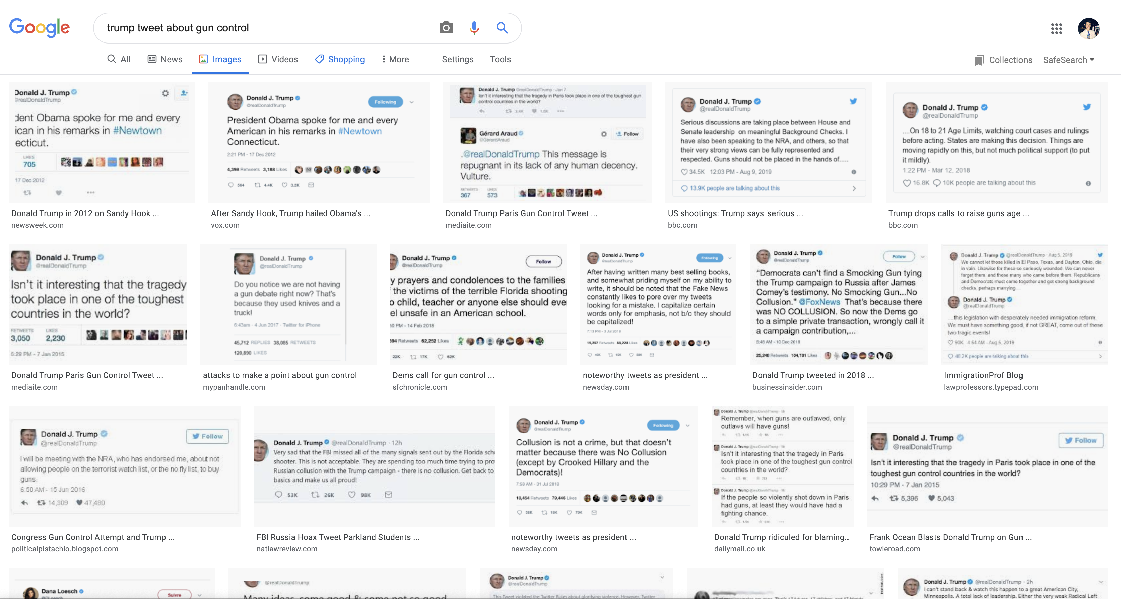
Notes:
For instance, any Google search of the form “Trump tweet about [some topic]” is destined to return many pages of hits.
But Trump isn’t the only person speaking his mind on social media, …
*CLICK*

Slide 4
% of Facebook/Twitter users who say __ of what they post on each site is related to politics
A lot
Some
A little
None
Facebook
6%
16%
27%
51%
Twitter
8
11
20
60
SOURCE: PEW RESEARCH CENTER
Notes:
A 2016 Pew Research survey found that about half of all Americans on Facebook and 40% of Twitter users report posting political content on the platform.
And these discussions are not confined to Facebook and Twitter.
*click*

Slide 5
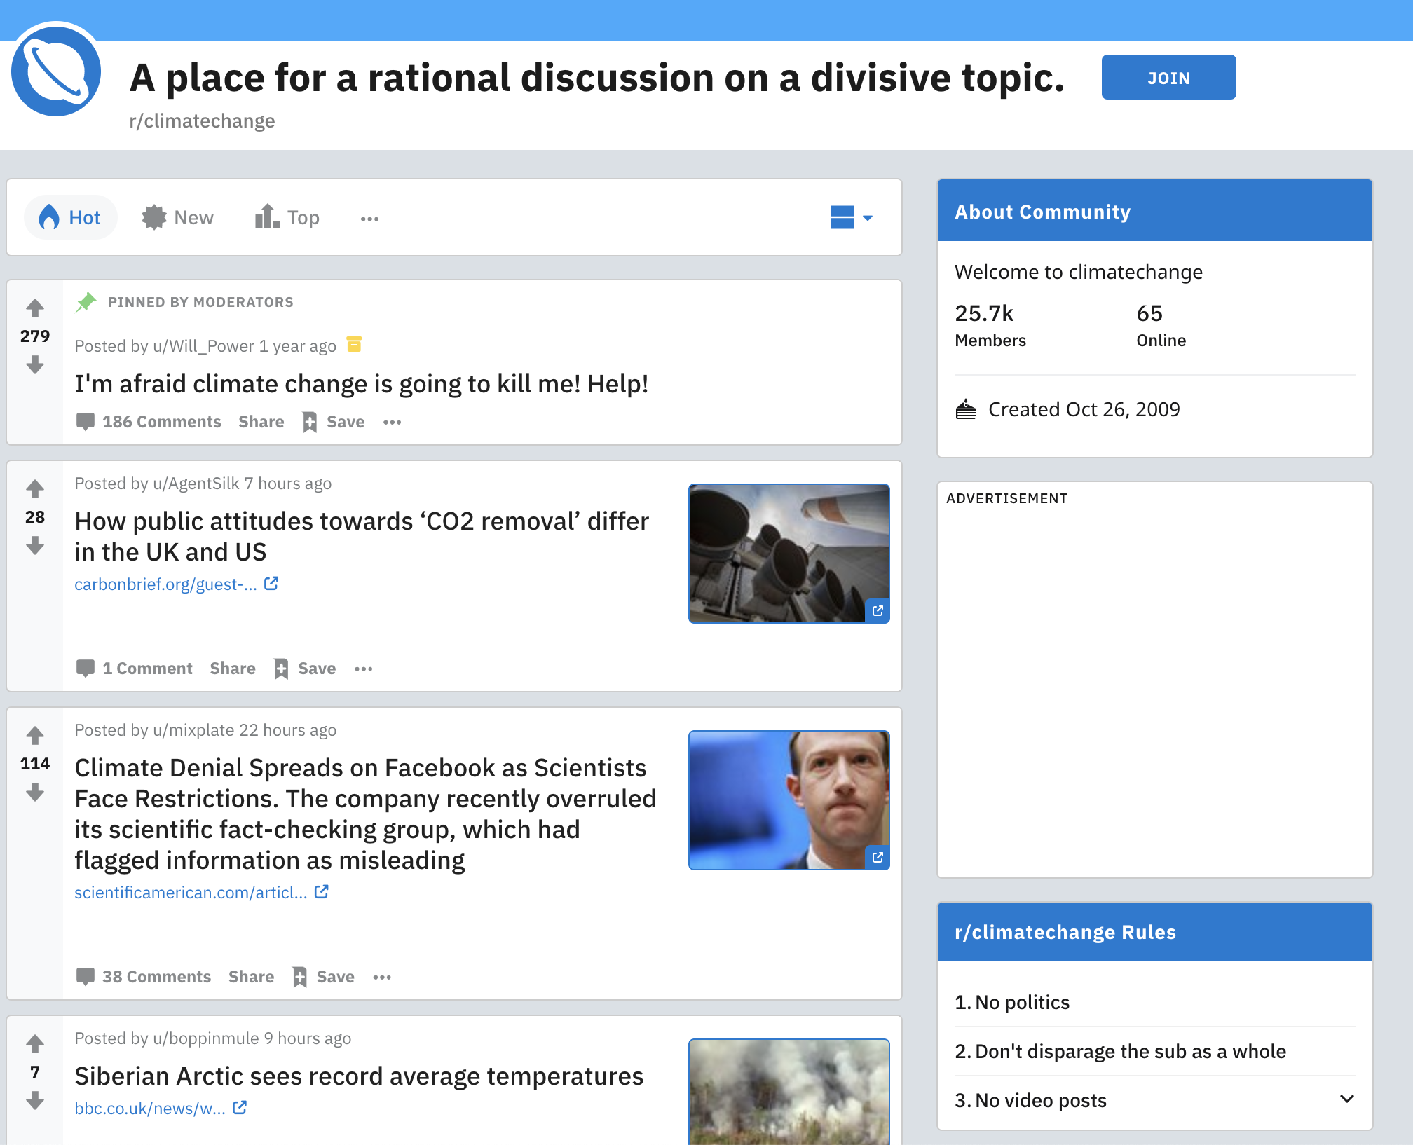
Notes:
On websites like Reddit, there are numerous forums devoted to discussing about all socially-relevant topics from climate change to
*click*

Slide 6

Notes:
Coronavirus
*click*

Slide 7
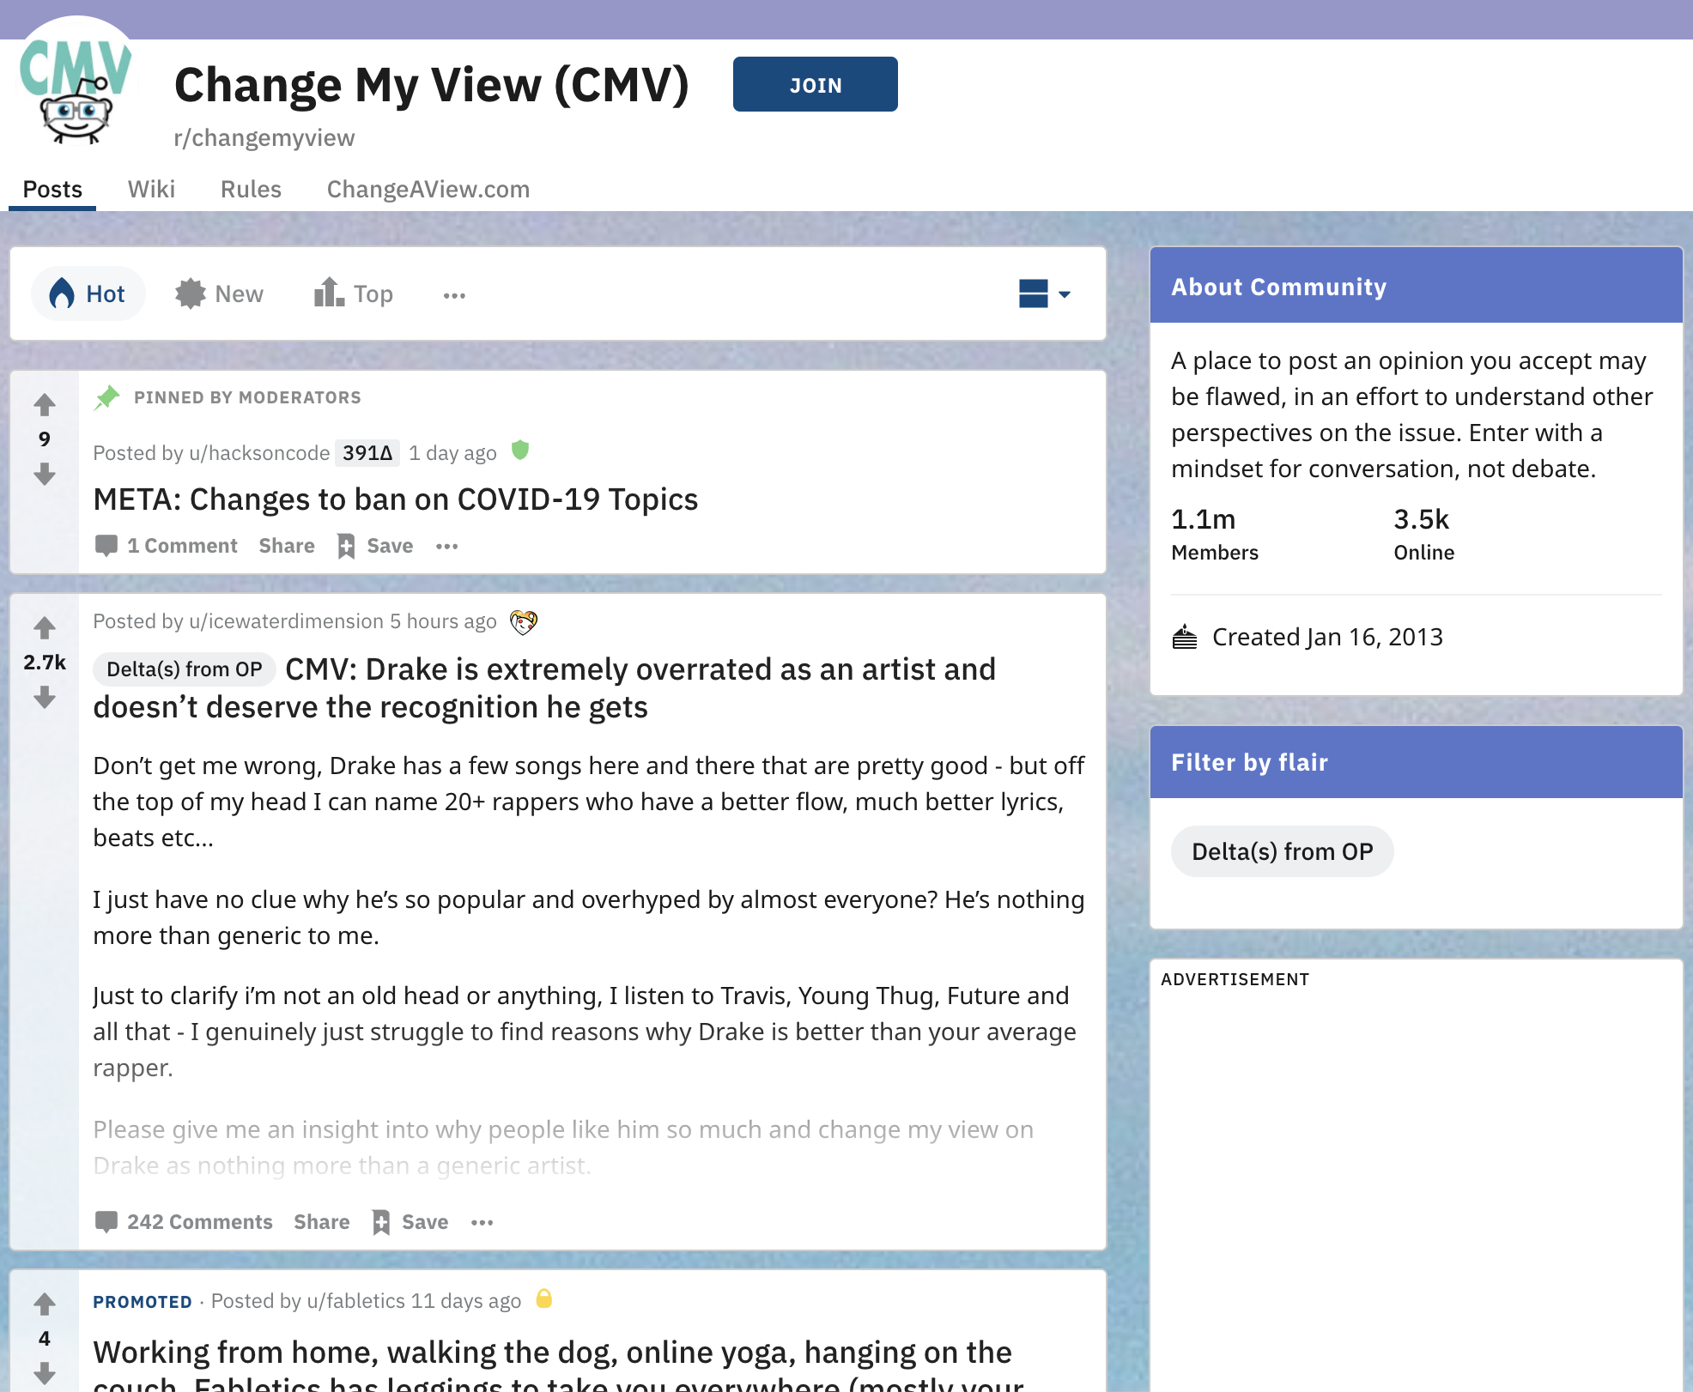
Notes:
There are even Reddit forums solely devoted to persuading others.
On the Reddit forum Change My View, for instance, users post their stance on issues pertaining to everything from the movies to science - fully knowing that others will reply to the post and try to change their view by providing counterarguments and counter-evidence.

Slide 8
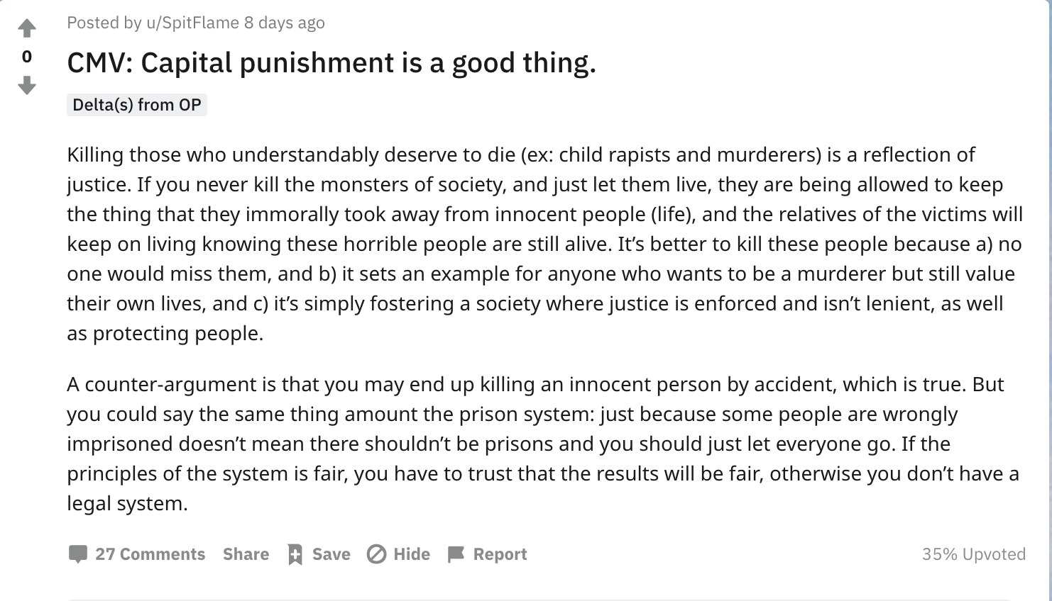
Notes:
Here is an example of a post on Change My View.

Slide 9
Notes:
The user is claiming that “Capital punishment is a good thing.”
*click*

Slide 10
Notes:
And they support their stance by writing a short argument justifying their views.
We see here that this user believes that capital punishment is morally permissible because some people (like “child rapists” and murderers) deserve to die.
In this study, we analyzed multiple Change My View posts about capital punishment to assess which types of beliefs and reasons support people's capital punishment attitudes.
*click*

Slide 11
Crowdsourcing Study: Overview
Research Questions
What topics arise when people defend their stance on capital punishment? Do topics vary by stance?
Notes:
More specifically, we examined if certain topics are more prevalent in the dataset than others. In turn, indicating which reasons people most commonly provide when justifying their stance on capital punishment.
Furthermore, we are also interested in if the prevalent topics change as a function of someone's attitude towards the issue.

Slide 12
Crowdsourcing Study: Overview
Research Questions
What topics arise when people defend their stance on capital punishment? Do topics vary by stance?
Data Collection
Reddit API (Python Reddit API Wrapper)
149 Change My View posts
55 anti-
94 pro-
Notes:
To answer these questions, we collected 149 Capital punishment posts from the Reddit forum CMV using the Reddit API wrapper PRAW. Posts were hand labeled by me as either supporting an anti- or pro- capital punishment stance.

Slide 13
Crowdsourcing Study: Overview
Topic Modeling
LDA: 5 topics
Topics are distributions over terms in corpus
Top 10 words define each topic
Fit one model to both groups of data
More art than science
Notes:
With this data set in hand, we then fit an unsupervised topic model, LDA.
LDA requires we pre-specify the number of topics we believe are in the dataset. Here, I will present you a model that assumes 5 topics in the dataset, however, varying the number of topics in the model does not lead to meaningfully different results.
LDA learns which topics are present in a dataset by looking at the distribution of terms in each document (here, people's posts to CMV) and grouping documents with similar term distributions into similar topics.
It is also important to note that there aren’t clear metrics that can effectively assess a topic model’s fit. Effective assessments rest largely on fitting multiple models and qualitatively interpreting trends in the results of the models. As a result, examining topic models is more art than science (an art that I am slowly learning) and even though I am presenting a single model here, multiple topic models informed our conclusions.

Slide 14
Crowdsourcing Study: Overview
Topic Modeling
LDA: 5 topics
Topics are distributions over terms in corpus
Top 10 words define each topic
Fit one model to both groups of data
More art than science
Qualitative Assessments
Interact with model using pyLDAViz
Notes:
To assist with the qualitative evaluations, we also used the tool pyLDAViz to interactively examine the learned topics for both models.
I will now discuss the results of the two topic models in more detail.

Slide 15
Crowdsourcing Study: Topic Modeling Results
Topic 1
Topic 2
Topic 3
Topic 4
Topic 5
Anti-Capital Punishment
Pro-Capital Punishment
Notes:
In each box, I will display the top words for each topic.
In the top row are the topics present in posts arguing against capital punishment.
In the bottom row are the topics present in posts arguing for capital punishment.
While we can make general topic comparisons across attitude type, we should not compare a single topic across attitude type.
For instance, we should not make comparisons between Topic 1 across both models because they are different models and have a different notion of what Topic 1 _is_.
Rather, we should look at general trends across all topics.
Hopefully, this will make more sense in a moment.

Slide 16
Crowdsourcing Study: Topic Modeling Results
Topic 1
Topic 2
Topic 3
Topic 4
Topic 5
kill, state, life, right, inherently, contradictory, high, give, tangible, barbaric
abolish, morally, currently, argument, call, killer, seem, insane, frequently, share
never, wrong, make, always, justify, bad, deserve, illegal, think, chance
think, eye, crime, option, pro, believe, world, harsh, Redditor, prison
crime, believe, wrong, state, morally, circumstance, right, people, serious, experience
Anti-Capital Punishment
Pro-Capital Punishment
Notes:
Here are the topics for posts against capital punishment.
We see words like “inherently” and “contradictory” in Topic 1, possibly indicating some people’s concerns for moral coherence
And terms like “eye” (as in 'eye-for-an-eye') and "harsh” compose Topic 4, possibly indicating concerns for the need for retribution.
Again, the terms shown in each box are the "top 10" terms assoicated with each topic.

Slide 17
Crowdsourcing Study: Topic Modeling Results
Topic 1
Topic 2
Topic 3
Topic 4
Topic 5
kill, state, life, right, inherently, contradictory, high, give, tangible, barbaric
abolish, morally, currently, argument, call, killer, seem, insane, frequently, share
never, wrong, make, always, justify, bad, deserve, illegal, think, chance
think, eye, crime, option, pro, believe, world, harsh, Redditor, prison
crime, believe, wrong, state, morally, circumstance, right, people, serious, experience
Anti-Capital Punishment
life, prison, give, crime, sentence, wrong, form, abolish, morally
crime, prison, child, sentence, life, make, favor, oppose, rape, standard
deserve, life, believe, murder, pro, crime, state, citizen, criminal, people
legal, people, murder, state, system, time, criminal, believe, innocent, kill
believe, use, method, crime, must, viable, consider, certain, state, replace
Pro-Capital Punishment
Notes:
And here are the topics for Pro-capital punishment posts.
At first glance, there may not be any obvious trends.
But if we consider prior research that suggests that people commonly rely on moral coherence, cost-benefit analyses, or the imperative of retribution to support their capital punishment attitudes, we can look at how terms related to these three types of reasoning are distributed through our corpus, and hopefully shed light on how many people choose to reason about capital punishment in a relatively naturalistic setting.

Slide 18
Crowdsourcing Study: Topic Modeling Results
Topic 1
Topic 2
Topic 3
Topic 4
Topic 5
kill, state, life, right, inherently, contradictory, high, give, tangible, barbaric
abolish, morally, currently, argument, call, killer, seem, insane, frequently, share
think, eye, crime, option, pro, believe, world, harsh, Redditor, prison
crime, believe, wrong, state, morally, circumstance, right, people, serious, experience
Terms indicating
Moral coherence
Cost considerations
Retribution concerns
never, wrong, make, always, justify, bad, deserve, illegal, think, chance
Anti-Capital Punishment
life, prison, give, crime, sentence, wrong, form, abolish, morally
crime, prison, child, sentence, life, make, favor, oppose, rape, standard
deserve, life, believe, murder, pro, crime, state, citizen, criminal, people
legal, people, murder, state, system, time, criminal, believe, innocent, kill
believe, use, method, crime, must, viable, consider, certain, state, replace
Pro-Capital Punishment
Notes:
To this end, I tagged words likely relating to reasoning driven by moral coherence, cost-benefit analyses, and the need of retribution.
We see that terms related to moral coherence and retribution are frequent in our topics, while cost considerations are not. This serves as preliminary evidence that people may rely more strongly on moral reasoning than statistical information when articulating their capital punishment attitudes.
To get a better sense of how frequently these terms are distributed through the corpus, we now turn to a visualization tool.

Slide 19
Crowdsourcing Study: Topic Modeling Results
pyLDAviz - Anti capital punishment posts
pyLDAviz - Pro capital punishment posts
Notes:
Let's look at the topic model fit to posts arguing against capital punishment. In the interest of time, I will not examine the pro capital punishment topics. But they tell a similar story as the anti capital punishment topics,

Slide 20
Crowdsourcing Study: Topic Modeling Results
Working hypothesis
Reasoning governed by moral coherence more prevalent than statistical reasoning
Notes:
From these assessments, the most pervasive class of terms in the dataset still appears to be terms indicative of reasoning governed by moral coherence, rather than statistical reasoning or cost-benefit analyses.

Slide 21
Crowdsourcing Study: Follow-up Analyses
Presence of terms indicating
Moral Coherence
Statistical Reasoning
Notes:
To confirm this exploratory finding, we set out to examine how frequently terms related to moral coherence and statistical reasoning appear in our dataset.

Slide 22
Crowdsourcing Study: Follow-up Analyses
Moral Foundations Dictionary 2.0 (Grimer, Boghrati, Haidt, Graham, & Dehgani, 2019)
Example terms: kindness (care + virtue), cheat (fairness + vice)
Statistical Reasoning Dictionary
Example terms: percent, data, sample, rate, cost
Notes:
To do this, we used two dictionaries of compiled terms.
We used the 2nd Moral Foundations Dictionary, which consists of terms associated with the five moral constructs posited by Moral Foundations Theory, to assess rates of moral reasoning. Example terms consist of …
We also built a set of every day statistical reasoning terms using popular Machine Learning techniques (details, see cogsci paper if interested). Example terms consist of …

Slide 23
Crowdsourcing Study: Follow-up Analyses
Notes:
Here I will show you the probability that a post uses a moral or a statistical term.
The x axis denotes the position the posts takes on capital punishment while the y axis denotes the probability that a given document contains a moral or a statistical term.

Slide 24
Crowdsourcing Study: Follow-up Analyses
Notes:
We see that the rates are fairly consistent across position, and that moral terms are used far more than statistical terms.
This finding indicates that moral coherence indeed plays a larger role in people’s attitudes than statistical and numerical information.

Slide 25
Crowdsourcing Study: Exploratory Analysis
People are using moral terms more than statistical terms
Remaining Questions
Do people refer to some moral constructs more than others?
How does moral term usage vary by political stance
Notes:
Open questions still remain, however. Such as, which types of moral considerations are most at play? And do *these* vary by stance?
Because the moral foundations dictionary relates each term to a moral construct, we can assess the rates at which different moral constructs appear in the corpus.

Slide 26
Crowdsourcing Study: Exploratory Analysis
Notes:
In the left box are moral vices and the right box contains moral virtues. Vices and virtues relate to the sentiment of the moral term used. For instance, the term ‘cheat’ is a vice while ‘kindness’ is a virtue.
Across the x axis are the different moral constructs assumed by moral foundations theory.

Slide 27
Crowdsourcing Study: Exploratory Analysis
Notes:
We see that Care as a vice is used far more frequently than other constructs.
Terms in this set consist of: Suffer, cruel, hurt, harm. This would confirm our prior intuitions about which moral constructs would be at play.
However, the virtuous authority and fairness terms are commonly used as well.
Future research will detail more closely how these different moral constructs each relate to people’s attitudes.

Slide 28
Crowdsourcing Study: Follow-up Analyses
Notes:
If we look at these trends by stance, we see that the distribution of terms is roughly the same.
This may indicate that both groups are considering the same moral factors. But because they have varying stances on capital punishment, it is likely they have opposing beliefs about those factors.
Future work needs to further quantify how these constructs are being discussed.

Slide 29
Discussion
What We Found
Used naturalistic data to examine capital punishment attitudes
Moral coherence more prominent than statistical reasoning
Notes:
To conclude, in this study we used naturalistic data from the Reddit forum change my view to examine which reasons most commonly support peoples’ stance on capital punishment.
We found that moral coherence likely plays a larger role than statistical information and this hold regardless of one's stance on the issue.

Slide 30
Discussion
What We Found
Used naturalistic data to examine capital punishment attitudes
Moral coherence more prominent than statistical reasoning
Limitations + Future Directions
Is the dataset representative (e.g., Priniski & Horne, 2019)?
Did our models overfit?
Empirical work on developing interventions
Target amenable beliefs
Notes:
This research of course has a few obvious limitations.
For one, how representative are CMV users? While previous research indicates that arguments persuasive on CMV are also persuasive in the lab, empirical research must validate this largely exploratory analysis directly.
When fitting models like this, it is also important to ensure that your models didn’t overfit to sample data, in turn limiting the generalizability of our claims. To assess this, future work should compute the out of sample predictions of our models on datasets culled from other websites like Twitter or Facebook.
Last, this work aimed to inspire future empirical work on developing interventions that can change people’s beliefs. Previous work indicates that effective interventions should target beliefs that are easier to change. If people’s attitudes are strongly rooted in moral reasoning, interventions presenting moral arguments may be attempting to revise deeply-entrenched beliefs – because the individual has already thought carefully about the moral factors. Therefore, interventions that present statistical information about the pros or cons of capital punishment may be more effective at shifting attitudes.
Future work is definitely in store.

Slide 31
Acknowledgements
Keith Holyoak UCLA
Hongjing Lu UCLA
Zach Horne University of Edinburgh
Bethany Growns Arizona State University
Sara Jaramillo University of Pittsburgh
Emily Line University of Illinois
Patricia Mirabile University of Amsterdam
Notes:
Thank you for listening to my talk and I would like to thank all of these people on helping me with this project, from begining to end.
~~~
I would like to thank my advisor and collaborator on this project Keith Holyoak for his help on this project
As well hongjung lu and zach horne who provided useful guidance early on in this project
As well as the others listed here who helped me greatly with making this presentation a cogent one.

